Slide 1
텐서플로와 머신러닝으로 시작하는
자연어처리
Lecture 5

Slide 2
Text Generation

Slide 3
Text Generation
What is Text Generation
What is Neural Machine Translation
Papers
Sequence to Sequence
How do we evaluate?
Neural Machine Translation Dataset

Slide 4
What is Text Generation

Slide 5
What is Text Generation

Slide 6
What is Text Generation
주어진 목적에 맞는 Text를 생성

Slide 7
What is Text Generation
주어진 목적에 맞는 Text를 생성
시 생성

Slide 8
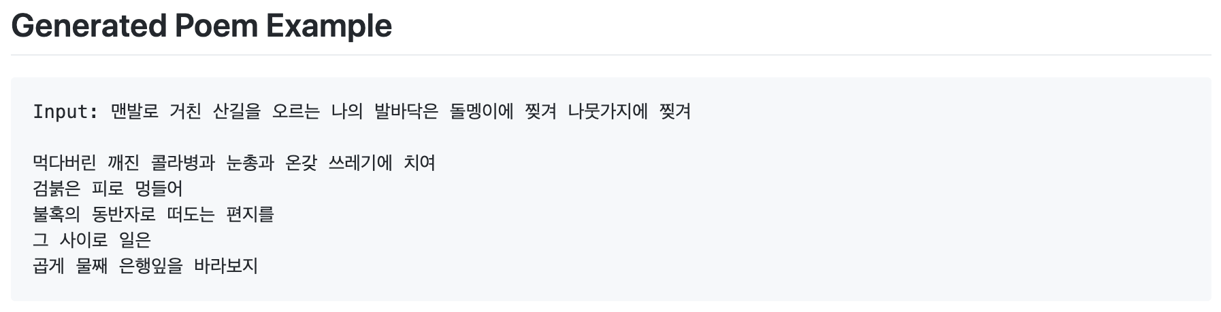
What is Text Generation
주어진 목적에 맞는 Text를 생성
시 생성
https://github.com/reniew/Seq2seq_poem_generation

Slide 9
What is Text Generation
주어진 목적에 맞는 Text를 생성
소설 생성

Slide 10

What is Text Generation
주어진 목적에 맞는 Text를 생성
소설 생성

Slide 11
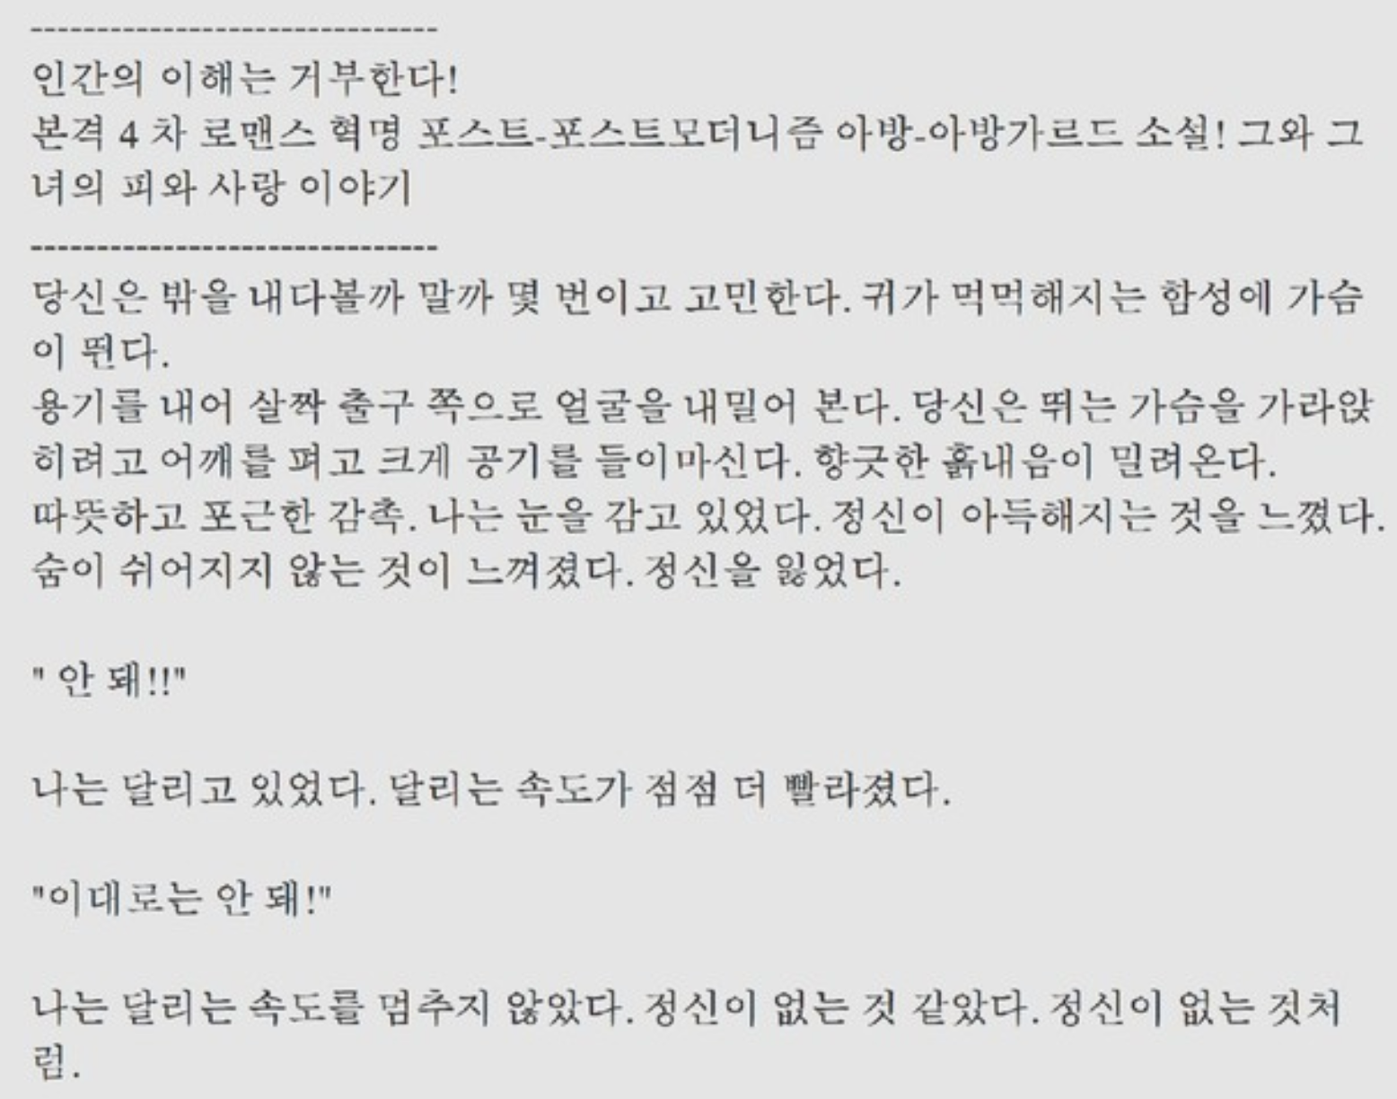
What is Text Generation
주어진 목적에 맞는 Text를 생성
소설 생성
https://speakerdeck.com/dreamgonfly/soseol-sseuneun-dib-reoning-pycon-korea-2018

Slide 12
What is Text Generation
주어진 목적에 맞는 Text를 생성
Image Captioning

Slide 13
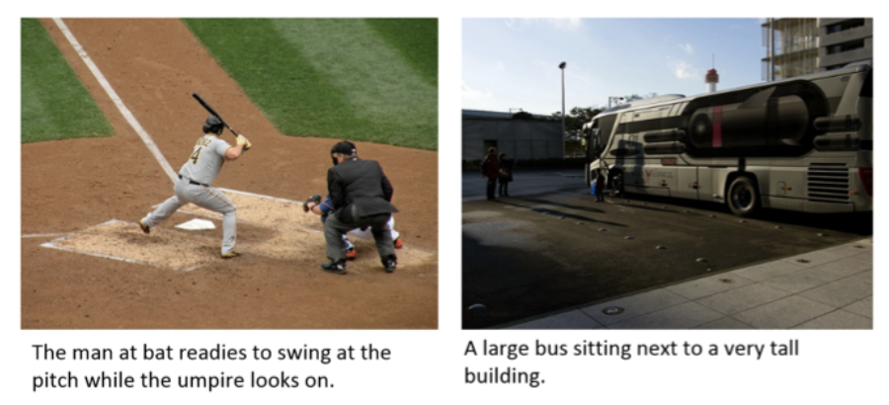
What is Text Generation
주어진 목적에 맞는 Text를 생성
Image Captioning

Slide 14
What is Text Generation
주어진 목적에 맞는 Text를 생성
Image Captioning

Slide 15
What is Text Generation
주어진 목적에 맞는 Text를 생성
➔ 번역 / 대화

Slide 16
What is Text Generation
주어진 목적에 맞는 Text를 생성
➔ 번역 / 대화
➔ Neural Machine Translation / Dialogue

Slide 17
What is Text Generation
주어진 목적에 맞는 Text를 생성
➔ 번역 / 대화
➔ Neural Machine Translation / Dialogue

Slide 18
What is Neural Machine Translation
신경망을 활용해 Source Language의 Text를 Target Language Text로 번역하는 Task

Slide 19
What is Neural Machine Translation
신경망을 활용해 Source Language의 Text를 Target Language Text로 번역하는 Task

Slide 20
What is Neural Machine Translation
신경망을 활용해 Source Language의 Text를 Target Language Text로 번역하는 Task

Slide 21
What is Neural Machine Translation
신경망을 활용해 Source Language의 Text를 Target Language Text로 번역하는 Task
Rule Based Machine Translation
(RBMT)
규칙 기반의 기계 번역
언어적인 정보를 바탕으로 규칙 수립

Slide 22
What is Neural Machine Translation
신경망을 활용해 Source Language의 Text를 Target Language Text로 번역하는 Task
Rule Based Machine Translation
(RBMT)
Source:
나는 학교에 가는 중이다.
대명사

Slide 23
What is Neural Machine Translation
신경망을 활용해 Source Language의 Text를 Target Language Text로 번역하는 Task
Rule Based Machine Translation
(RBMT)
Source:
나는 학교에 가는 중이다.
대명사
I (NP)

Slide 24
What is Neural Machine Translation
신경망을 활용해 Source Language의 Text를 Target Language Text로 번역하는 Task
Rule Based Machine Translation
(RBMT)
Source:
나는 학교에 가는 중이다.
조사

Slide 25
What is Neural Machine Translation
신경망을 활용해 Source Language의 Text를 Target Language Text로 번역하는 Task
Rule Based Machine Translation
(RBMT)
Source:
나는 학교에 가는 중이다.
조사
am (suffix)

Slide 26
What is Neural Machine Translation
신경망을 활용해 Source Language의 Text를 Target Language Text로 번역하는 Task
Rule Based Machine Translation
(RBMT)
Source:
나는 학교에 가는 중이다.
명사
school (NP)

Slide 27
What is Neural Machine Translation
신경망을 활용해 Source Language의 Text를 Target Language Text로 번역하는 Task
Rule Based Machine Translation
(RBMT)
Source:
나는 학교에 가는 중이다.
…
… (…)

Slide 28
What is Neural Machine Translation
신경망을 활용해 Source Language의 Text를 Target Language Text로 번역하는 Task
Rule Based Machine Translation
(RBMT)
Source:
나는 학교에 가는 중이다.
…
… (…)

Slide 29
What is Neural Machine Translation
신경망을 활용해 Source Language의 Text를 Target Language Text로 번역하는 Task
Rule Based Machine Translation
(RBMT)
Source:
나는 학교에 가는 중이다.
…
… (…)

Slide 30
What is Neural Machine Translation
신경망을 활용해 Source Language의 Text를 Target Language Text로 번역하는 Task
Rule Based Machine Translation
(RBMT)
Source:
나는 학교에 가는 중이다.
I am going to school

Slide 31
What is Neural Machine Translation
신경망을 활용해 Source Language의 Text를 Target Language Text로 번역하는 Task
Rule Based Machine Translation
(RBMT)
Source:
나는 학교에 가는 중이다.
I am going to school

Slide 32
What is Neural Machine Translation
신경망을 활용해 Source Language의 Text를 Target Language Text로 번역하는 Task
Rule Based Machine Translation
(RBMT)
Source:
나는 학교에 가는 중이다.
I am school going

Slide 33
What is Neural Machine Translation
신경망을 활용해 Source Language의 Text를 Target Language Text로 번역하는 Task
Statistical Machine Translation
(SMT)

Slide 34
What is Neural Machine Translation
신경망을 활용해 Source Language의 Text를 Target Language Text로 번역하는 Task
Statistical Machine Translation
(SMT)
Text 데이터를 통해 계산된 확률 모델을 사용해 번역

Slide 35
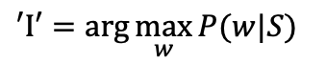
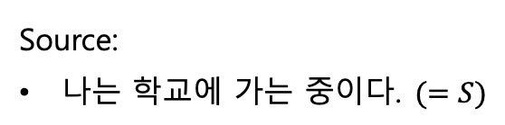
What is Neural Machine Translation
신경망을 활용해 Source Language의 Text를 Target Language Text로 번역하는 Task
Statistical Machine Translation
(SMT)
Source:
나는 학교에 가는 중이다.$(=S)$
$$′I′=\arg{\max_{w}{P(w|S)}}$$

Slide 36
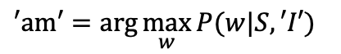
What is Neural Machine Translation
신경망을 활용해 Source Language의 Text를 Target Language Text로 번역하는 Task
Statistical Machine Translation
(SMT)
Source:
나는 학교에 가는 중이다.$(=S)$
$$′am′=\arg{\max_{w}{P(w|S, ′I′)}}$$

Slide 37
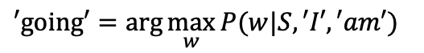
What is Neural Machine Translation
신경망을 활용해 Source Language의 Text를 Target Language Text로 번역하는 Task
Statistical Machine Translation
(SMT)
Source:
나는 학교에 가는 중이다.$(=S)$
$$′going′=\arg{\max_{w}{P(w|S, ′I′, ′am′)}}$$

Slide 38
What is Neural Machine Translation
신경망을 활용해 Source Language의 Text를 Target Language Text로 번역하는 Task
Neural Machine Translation
(NMT)
Neural Network를 사용해 Text Data를 학습해 주어진 문장을 번역
2014년 Sequence to Sequence 모델로 Neural Machine Translation 개념이 등장

Slide 39
What is Neural Machine Translation
신경망을 활용해 Source Language의 Text를 Target Language Text로 번역하는 Task
Neural Machine Translation
(NMT)
Sequence to Sequence Learning with Neural Networks
Learning Phrase Representations using RNN Encoder–Decoder for Statistical Machine Translation

Slide 40
Neural Machine Translation Architecture

Slide 41
Neural Machine Translation Architecture
Encoder
Decoder

Slide 42
Neural Machine Translation Architecture
Translated Text
Encoder
Decoder
Input Text

Slide 43
Neural Machine Translation Architecture
I am going to school
Encoder
Decoder
나는 학교에 가는 중이다.

Slide 44
Neural Machine Translation Architecture
I am going to school
Encoder
Decoder
나는 학교에 가는 중이다.
Encoder–Decoder Architecture

Slide 45
Neural Machine Translation Architecture
I am going to school
Encoder
Decoder
나는 학교에 가는 중이다.
Sequence to Sequence Model

Slide 46
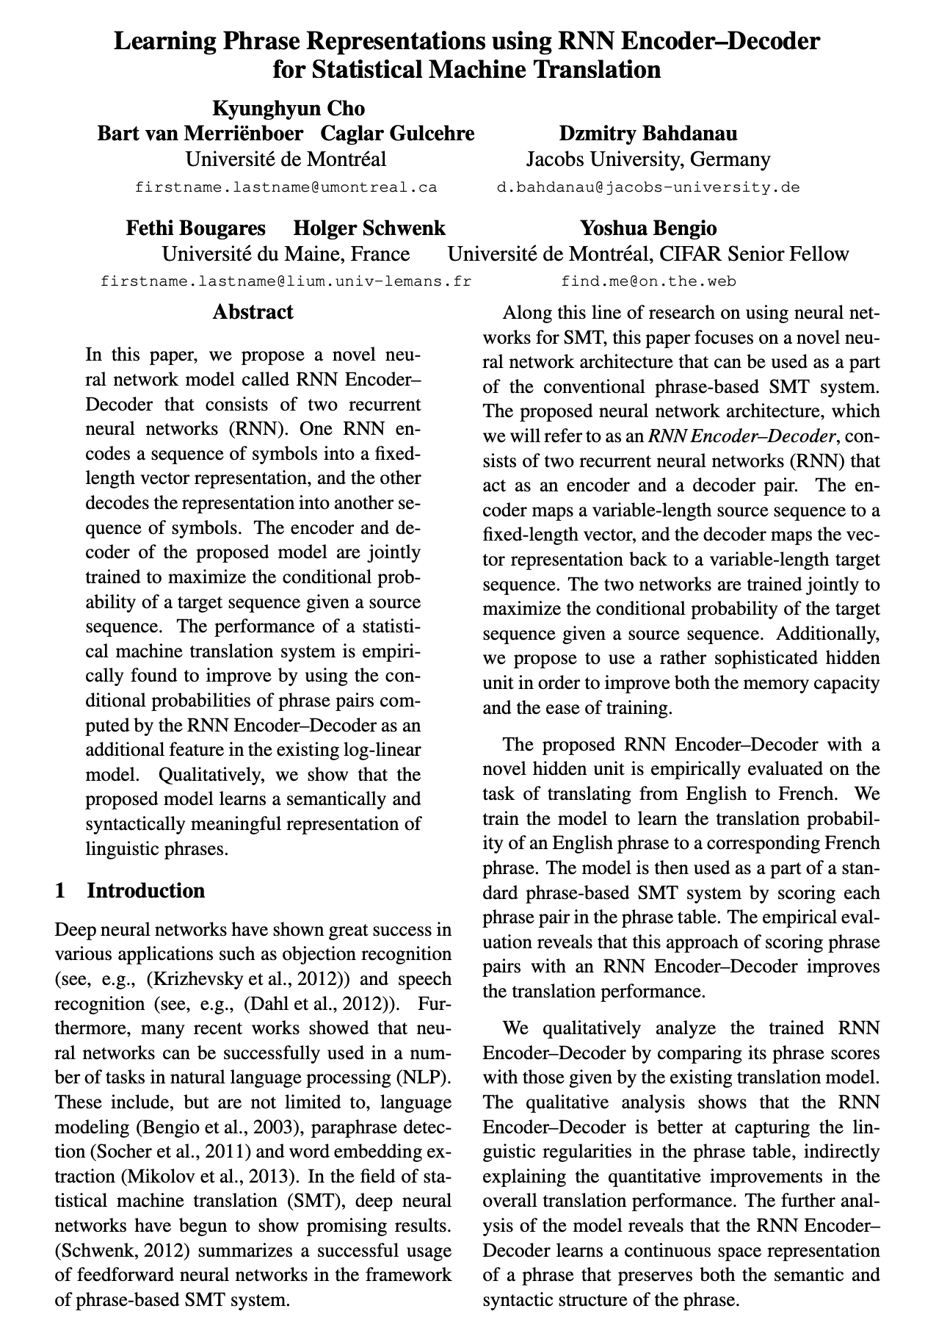
Neural Machine Translation

Slide 47
Neural Machine Translation
Cho et al. (2014)

Slide 48
Neural Machine Translation
Cho et al. (2014)
Encoder-Decoder 구조를 처음 제시

Slide 49
Neural Machine Translation
Cho et al. (2014)
Encoder-Decoder 구조를 처음 제시
NMT의 시발점이 된 논문

Slide 50
Neural Machine Translation
Cho et al. (2014)
Encoder-Decoder 구조를 처음 제시
NMT의 시발점이 된 논문
하지만 해당 논문에서는 해당 신경망 모델을 기계 번역에 직접 적용하지 않음

Slide 51
Neural Machine Translation
Cho et al. (2014)
Encoder-Decoder 구조를 처음 제시
NMT의 시발점이 된 논문
하지만 해당 논문에서는 해당 신경망 모델을 기계 번역에 직접 적용하지 않음
기존의 가장 높은 성능을 보이던 Phrase-based SMT 모델에 적용시킴

Slide 52
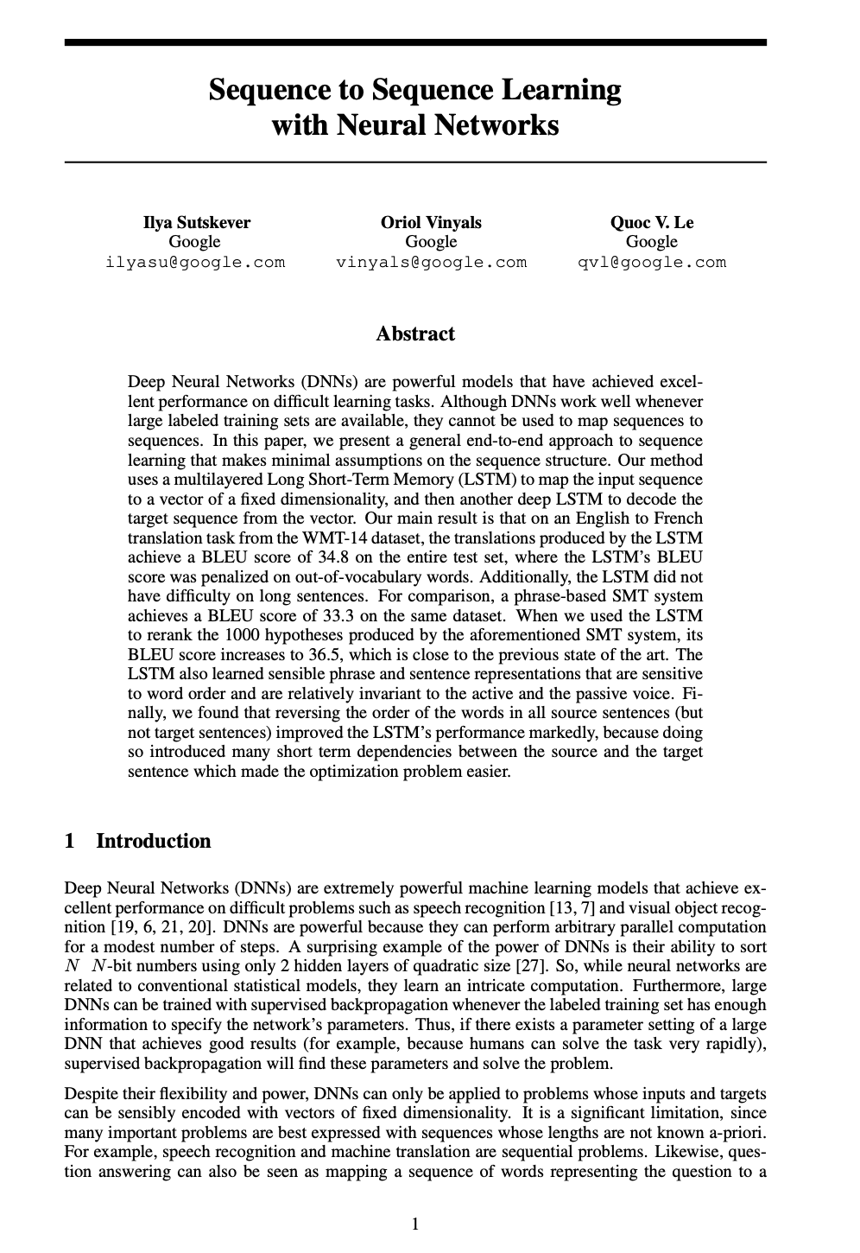
Neural Machine Translation

Slide 53
Neural Machine Translation
Sutskever et al. (2014, Google)

Slide 54
Neural Machine Translation
Sutskever et al. (2014, Google)
본격적인 NMT 모델의 시작

Slide 55
Neural Machine Translation
Sutskever et al. (2014, Google)
본격적인 NMT 모델의 시작
RNN 을 사용해 Input 과 output을 modeling함

Slide 56
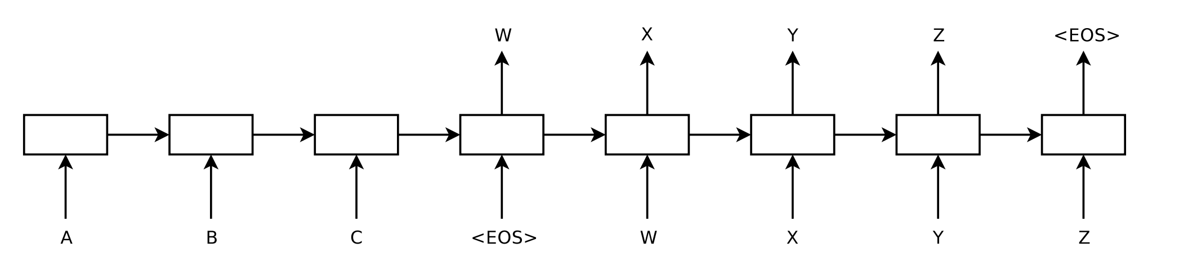
Sequence to Sequence Learning with Neural Networks

Slide 57
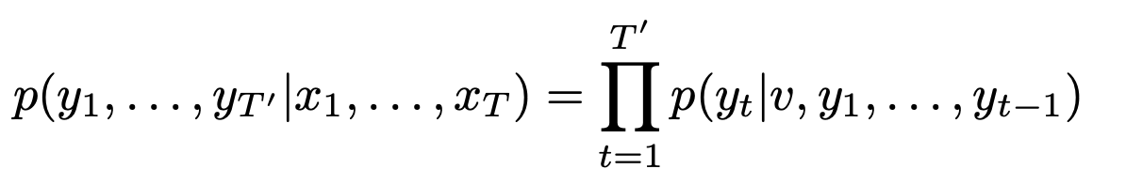
Sequence to Sequence Learning with Neural Networks

Slide 58
Sequence to Sequence Learning with Neural Networks
Input

Slide 59
Sequence to Sequence Learning with Neural Networks
Input Sentence LSTM

Slide 60
Sequence to Sequence Learning with Neural Networks
Output Sentence LSTM (first step)

Slide 61
Sequence to Sequence Learning with Neural Networks
Output Sentence LSTM (first step)

Slide 62
Sequence to Sequence Learning with Neural Networks
Output Sentence LSTM (second step)

Slide 63
Sequence to Sequence Learning with Neural Networks
Output Sentence LSTM (second step)

Slide 64
Sequence to Sequence Learning with Neural Networks
Output Sentence LSTM (third step)

Slide 65
Sequence to Sequence Learning with Neural Networks
Output Sentence LSTM (third step)

Slide 66
Sequence to Sequence Learning with Neural Networks
Output Sentence LSTM (fourth step)

Slide 67
Sequence to Sequence Learning with Neural Networks
Output Sentence LSTM (fifth step)

Slide 68
Sequence to Sequence Learning with Neural Networks
Important things of model

Slide 69
Sequence to Sequence Learning with Neural Networks
Important things of model
Using different two LSTM

Slide 70
Sequence to Sequence Learning with Neural Networks
Important things of model
Using different two LSTM

Slide 71
Sequence to Sequence Learning with Neural Networks
Important things of model
Using different two LSTM
Deep LSTM(4 layer)

Slide 72
Sequence to Sequence Learning with Neural Networks
Important things of model
Using different two LSTM
Deep LSTM(4 layer)
Reverse the order of words of the input sentences

Slide 73
Sequence to Sequence Learning with Neural Networks
C
B
A
Important things of model
Using different two LSTM
Deep LSTM(4 layer)
Reverse the order of words of the input sentences

Slide 74
How do we evaluate translation quality

Slide 75
How do we evaluate Translation quality

Slide 76
How do we evaluate Translation quality
아침을 너무 오래 먹어서 수업에 지각했다.

Slide 77
How do we evaluate Translation quality
아침을 너무 오래 먹어서 수업에 지각했다.
I was late for class as I ate breakfast too long

Slide 78
How do we evaluate Translation quality
아침을 너무 오래 먹어서 수업에 지각했다.
I was late for class as I ate breakfast too long
I ate breakfast so long that I was late for class.

Slide 79
How do we evaluate Translation quality
아침을 너무 오래 먹어서 수업에 지각했다.
I was late for class as I ate breakfast too long
I ate breakfast so long that I was late for class.
Because I ate breakfast too long, I was late for class.

Slide 80
How do we evaluate Translation quality
아침을 너무 오래 먹어서 수업에 지각했다.
I was late for class as I ate breakfast too long.
I ate breakfast so long that I was late for class.
Because I ate breakfast too long, I was late for class.
How do we evaluate???

Slide 81
BLEU Score

Slide 82
BLEU Score
Bilingual Evaluation Understudy

Slide 83
BLEU Score
Bilingual Evaluation Understudy
기계 번역된 Text의 품질을 평가하기 위한 알고리즘 중 하나.

Slide 84
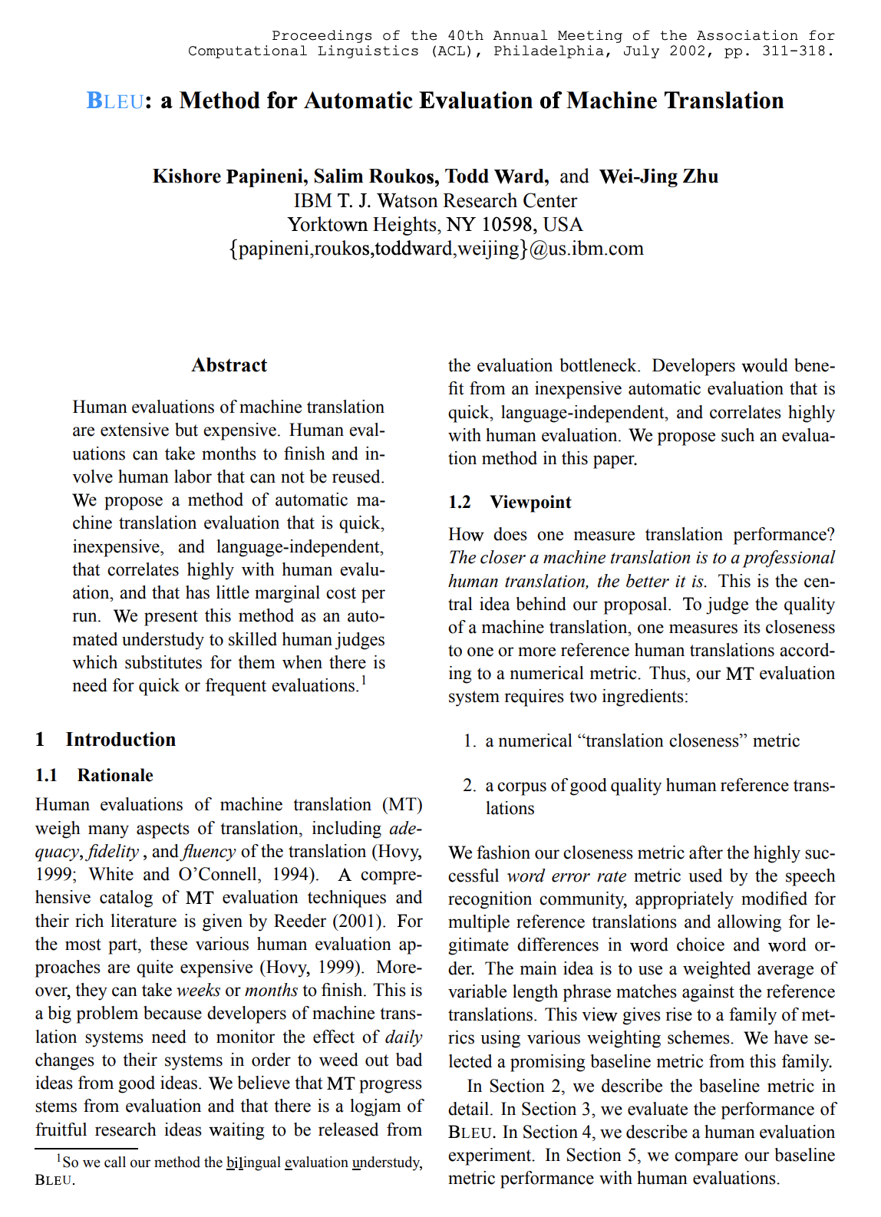
BLEU Score
Bilingual Evaluation Understudy
기계 번역된 Text의 품질을 평가하기 위한 알고리즘 중 하나.

Slide 85
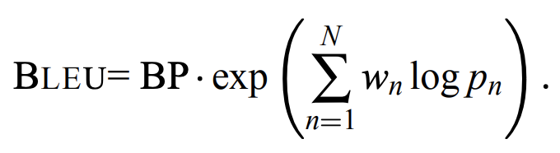
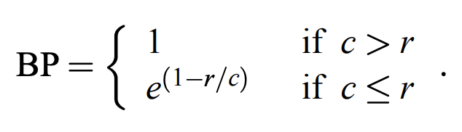
BLEU Score
Bilingual Evaluation Understudy
기계 번역된 Text의 품질을 평가하기 위한 알고리즘 중 하나.

Slide 86
BLEU Score
Example.
Candidate 1: It is a guide to action which ensures that the military always obeys the commands of the party.
Candidate 2: It is to insure the troops forever hearing the activity guidebook that party direct.

Slide 87
BLEU Score
Example.
Candidate 1: It is a guide to action which ensures that the military always obeys the commands of the party.
Candidate 2: It is to insure the troops forever hearing the activity guidebook that party direct.
Reference 1: It is a guide to action that ensures that the military will forever heed Party commands.
Reference 2: It is the guiding principle which guarantees the military forces always being under the command of the Party.
Reference 3: It is the practical guide for the army always to heed the directions of the party.

Slide 88
BLEU Score
Example.
Candidate 1: It is a guide to action which ensures that the military always obeys the commands of the party.
Candidate 2: It is to insure the troops forever hearing the activity guidebook that party direct.
더 높은 점수 가져야 함
Reference 1: It is a guide to action that ensures that the military will forever heed Party commands.
Reference 2: It is the guiding principle which guarantees the military forces always being under the command of the Party.
Reference 3: It is the practical guide for the army always to heed the directions of the party.

Slide 89
BLEU Score
Example.
Candidate 1: It is a guide to action which ensures that the military always obeys the commands of the party.
Candidate 2: It is to insure the troops forever hearing the activity guidebook that party direct.
더 높은 점수 가져야 함
How?
Reference 1: It is a guide to action that ensures that the military will forever heed Party commands.
Reference 2: It is the guiding principle which guarantees the military forces always being under the command of the Party.
Reference 3: It is the practical guide for the army always to heed the directions of the party.

Slide 90
BLEU Score
Example.
Candidate 1: It is a guide to action which ensures that the military always obeys the commands of the party.
Candidate 2: It is to insure the troops forever hearing the activity guidebook that party direct.
더 높은 점수 가져야 함
N-Gram precision
Reference 1: It is a guide to action that ensures that the military will forever heed Party commands.
Reference 2: It is the guiding principle which guarantees the military forces always being under the command of the Party.
Reference 3: It is the practical guide for the army always to heed the directions of the party.

Slide 91
BLEU Score
N-Gram precision

Slide 92
BLEU Score
N-Gram precision

Slide 93
BLEU Score
N-Gram precision
주어진 Text에서 연속된 N개의 Sequence를 하나의 item으로 봄

Slide 94
BLEU Score
N-Gram precision
주어진 Text에서 연속된 N개의 Sequence를 하나의 item으로 봄
Example)
I was too late for class today.

Slide 95
BLEU Score
N-Gram precision
주어진 Text에서 연속된 N개의 Sequence를 하나의 item으로 봄
Example)
I was too late for class today.
Uni-Gram(1-Gram)
=> I / was / too / late / for / class / today

Slide 96
BLEU Score
N-Gram precision
주어진 Text에서 연속된 N개의 Sequence를 하나의 item으로 봄
Example)
I was too late for class today.
Uni-Gram(1-Gram)
=> I / was / too / late / for / class / today
Bi-Gram(2-Gram)
=> I, was / was, too / too, late / late, for / for , class / class, today

Slide 97
BLEU Score
N-Gram precision
주어진 Text에서 연속된 N개의 Sequence를 하나의 item으로 봄
Example)
I was too late for class today.
Uni-Gram(1-Gram)
=> I / was / too / late / for / class / today
Bi-Gram(2-Gram)
=> I, was / was, too / too, late / late, for / for , class / class, today
Tri-Gram(3-Gram)
=> I, was, too / was, too, late / too, late, for / late, for, class, / for, class, today

Slide 98
BLEU Score
N-Gram precision

Slide 99
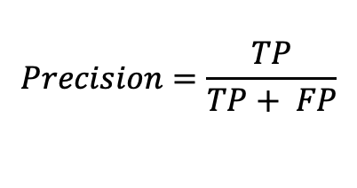
BLEU Score
N-Gram precision
Actual
$$Precision=\frac{TP}{TP+ FP}$$
 | Positive | Negative
Positive | TP | FP
Negative | FN | TN
Predicted
Classifier가 Positive로 예측한 값 중 실제 Positive 비율

Slide 100
BLEU Score
N-Gram precision
Candidate(Translated Text)의 N-Gram이 Reference와 얼마나 겹치는지 계산한 Precision

Slide 101
BLEU Score
N-Gram precision
Example.
Candidate 1: It is a guide to action which ensures that the military always obeys the commands of the party.
Candidate 2: It is to insure the troops forever hearing the activity guidebook that party direct.
Reference 1: It is a guide to action that ensures that the military will forever heed Party commands.
Reference 2: It is the guiding principle which guarantees the military forces always being under the command of the Party.
Reference 3: It is the practical guide for the army always to heed the directions of the party.

Slide 102
BLEU Score
N-Gram precision
Example.
Candidate 1: It is a guide to action which ensures that the military always obeys the commands of the party.
Candidate 2: It is to insure the troops forever hearing the activity guidebook that party direct.
Reference 1: It is a guide to action that ensures that the military will forever heed Party commands.
Reference 2: It is the guiding principle which guarantees the military forces always being under the command of the Party.
Reference 3: It is the practical guide for the army always to heed the directions of the party.

Slide 103
BLEU Score
Uni-Gram precision
Example.
Candidate 1: It is a guide to action which ensures that the military always obeys the commands of the party.
Candidate 2: It is to insure the troops forever hearing the activity guidebook that party direct.
Reference 1: It is a guide to action that ensures that the military will forever heed Party commands.
Reference 2: It is the guiding principle which guarantees the military forces always being under the command of the Party.
Reference 3: It is the practical guide for the army always to heed the directions of the party.

Slide 104
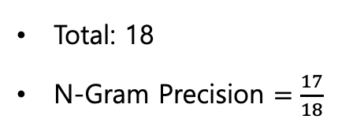
BLEU Score
Uni-Gram precision
Example.
Candidate 1: It is a guide to action which ensures that the military always obeys the commands of the party.
Candidate 2: It is to insure the troops forever hearing the activity guidebook that party direct.
Total: 18
N-Gram Precision $=\frac{17}{18}$
Reference 1: It is a guide to action that ensures that the military will forever heed Party commands.
Reference 2: It is the guiding principle which guarantees the military forces always being under the command of the Party.
Reference 3: It is the practical guide for the army always to heed the directions of the party.

Slide 105
BLEU Score
N-Gram precision
Example.
Candidate 1: It is a guide to action which ensures that the military always obeys the commands of the party.
Candidate 2: It is to insure the troops forever hearing the activity guidebook that party direct.
Reference 1: It is a guide to action that ensures that the military will forever heed Party commands.
Reference 2: It is the guiding principle which guarantees the military forces always being under the command of the Party.
Reference 3: It is the practical guide for the army always to heed the directions of the party.

Slide 106
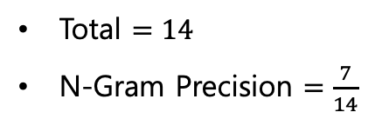
BLEU Score
N-Gram precision
Example.
Candidate 1: It is a guide to action which ensures that the military always obeys the commands of the party.
Candidate 2: It is to insure the troops forever hearing the activity guidebook that party direct.
Total $=14$
N-Gram Precision $=\frac{7}{14}$
Reference 1: It is a guide to action that ensures that the military will forever heed Party commands.
Reference 2: It is the guiding principle which guarantees the military forces always being under the command of the Party.
Reference 3: It is the practical guide for the army always to heed the directions of the party.
비교 추가

Slide 107
BLEU Score
Issue of N-Gram precision
Example.
Candidate 1: the the the the the the the
Reference 1: The cat is on the mat
Reference 2: There is a cat on the mat

Slide 108
BLEU Score
Issue of N-Gram precision
Example.
Candidate 1: the the the the the the the
Totally Wrong!!!
Reference 1: The cat is on the mat
Reference 2: There is a cat on the mat

Slide 109
BLEU Score
Issue of N-Gram precision
Example.
Candidate 1: the the the the the the the
Reference 1: The cat is on the mat
Reference 2: There is a cat on the mat

Slide 110
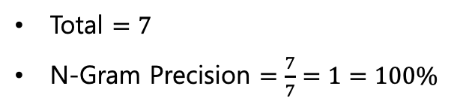
BLEU Score
Issue of N-Gram precision
Example.
Candidate 1: the the the the the the the
Total $=7$
N-Gram Precision $=\frac{7}{7}=1=100\%$
Reference 1: The cat is on the mat
Reference 2: There is a cat on the mat

Slide 111
BLEU Score
Issue of N-Gram precision
Example.
Candidate 1: the the the the the the the
Total $=7$
N-Gram Precision $=\frac{7}{7}=1=100\%$
Reference 1: The cat is on the mat
Reference 2: There is a cat on the mat
Perfect??

Slide 112
BLEU Score
Issue of N-Gram precision
Example.
Candidate 1: the the the the the the the
Total $=7$
N-Gram Precision $=\frac{7}{7}=1=100\%$
Reference 1: The cat is on the mat
Reference 2: There is a cat on the mat
”Reasonable” word over-generating

Slide 113
BLEU Score
Solution for ”Reasonable” word over-generating

Slide 114
BLEU Score
Solution for ”Reasonable” word over-generating
Clipping maximum reference count
Using different “N” in N-gram precision

Slide 115
BLEU Score
Solution for ”Reasonable” word over-generating
Clipping maximum reference count
Using different “N” in N-gram precision

Slide 116
BLEU Score
Solution for ”Reasonable” word over-generating
Clipping maximum reference count
Using different “N” in N-gram precision
Example.
Candidate 1: the the the the the the the
Reference 1: The cat is on the mat
Reference 2: There is a cat on the mat

Slide 117
BLEU Score
Solution for ”Reasonable” word over-generating
Clipping maximum reference count
Using different “N” in N-gram precision
Example.
Candidate 1: the the the the the the the
Reference 1: The cat is on the mat
Reference 2: There is a cat on the mat

Slide 118
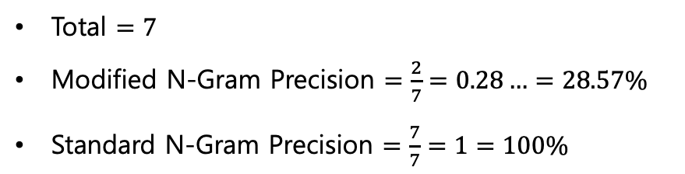
BLEU Score
Solution for ”Reasonable” word over-generating
Clipping maximum reference count
Using different “N” in N-gram precision
Example.
Candidate 1: the the the the the the the
Total $=7$
Modified N-Gram Precision $=\frac{2}{7}=0.28…=28.57\%$
Standard N-Gram Precision $=\frac{7}{7}=1=100\%$
Reference 1: The cat is on the mat
Reference 2: There is a cat on the mat

Slide 119
BLEU Score
Solution for ”Reasonable” word over-generating
Clipping maximum reference count
Using different “N” in N-gram precision

Slide 120
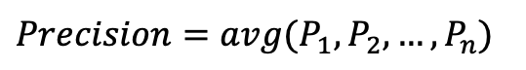
BLEU Score
Solution for ”Reasonable” word over-generating
Clipping maximum reference count
Using different “N” in N-gram precision
$$Precision=avg(P_{1}, P_{2}, …, P_{n})$$

Slide 121
BLEU Score
Solution for ”Reasonable” word over-generating
Clipping maximum reference count
Using different “N” in N-gram precision
$$Precision=avg(P_{1}, P_{2}, …, P_{n})$$
큰 N에 대해서 Precision이 높을 수록 더 정확한 번역

Slide 122
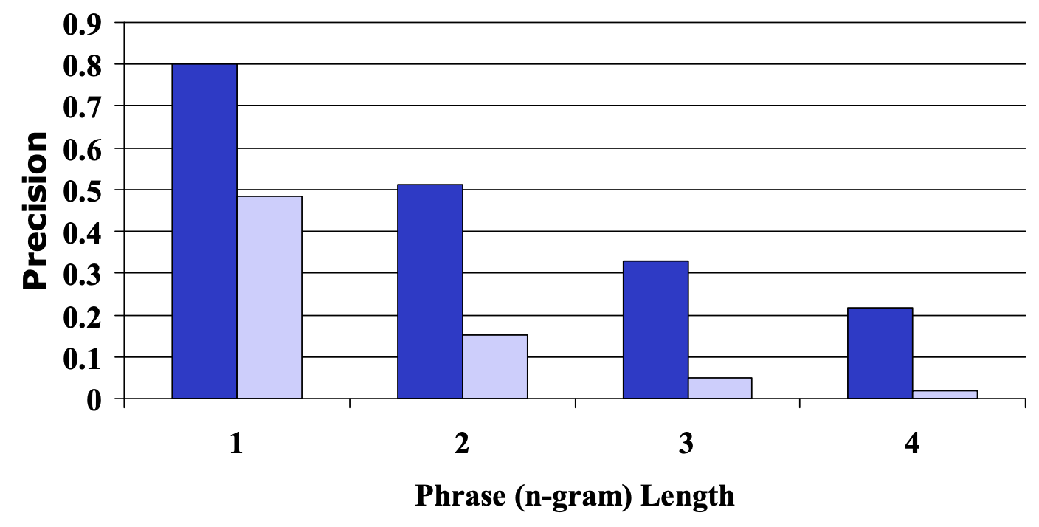
BLEU Score
Solution for ”Reasonable” word over-generating
Clipping maximum reference count
Using different “N” in N-gram precision
$$Precision=avg(P_{1}, P_{2}, …, P_{n})$$
큰 N에 대해서 Precision이 높을 수록 더 정확한 번역
Blue => Human
Light blue => Machine

Slide 123
BLEU Score
Solution for ”Reasonable” word over-generating
Clipping maximum reference count
Using different “N” in N-gram precision
$$Precision=avg(P_{1}, P_{2}, …, P_{n})$$
큰 N에 대해서 Precision이 높을 수록 더 정확한 번역
N이 커질수록 지수적(exponential)으로 줄어든다
Blue => Human
Light blue => Machine

Slide 124
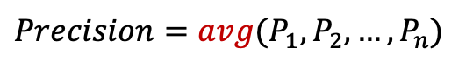
BLEU Score
Solution for ”Reasonable” word over-generating
Clipping maximum reference count
Using different “N” in N-gram precision
$$Precision=avg(P_{1}, P_{2}, …, P_{n})$$
큰 N에 대해서 Precision이 높을 수록 더 정확한 번역
N이 커질수록 지수적(exponential)으로 줄어든다.
큰 N에 대응할 수 있도록 기하 평균 사용
Blue => Human
Light blue => Machine

Slide 125
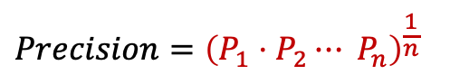
BLEU Score
Solution for ”Reasonable” word over-generating
Clipping maximum reference count
Using different “N” in N-gram precision
$$Precision={\left(P_{1}⋅P_{2}⋯ P_{n}\right)}^{\frac{1}{n}}$$
큰 N에 대해서 Precision이 높을 수록 더 정확한 번역
N이 커질수록 지수적(exponential)으로 줄어든다.
큰 N에 대응할 수 있도록 기하 평균 사용
경우에 따라 산술 평균도 사용할 수 있음
Blue => Human
Light blue => Machine

Slide 126
BLEU Score
Second Issue of N-Gram precision

Slide 127
BLEU Score
Second Issue of N-Gram precision
Example.
Candidate 1: of the
Reference 1: It is a guide to action that ensures that the military will forever heed Party commands.
Reference 2: It is the guiding principle which guarantees the military forces always being under the command of the Party.
Reference 2: It is the practical guide for the army always to heed directions of the party.

Slide 128
BLEU Score
Second Issue of N-Gram precision
Example.
Candidate 1: of the
Reference 1: It is a guide to action that ensures that the military will forever heed Party commands.
Reference 2: It is the guiding principle which guarantees the military forces always being under the command of the Party.
Reference 2: It is the practical guide for the army always to heed directions of the party.

Slide 129
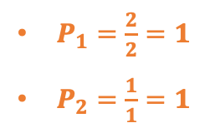
BLEU Score
Second Issue of N-Gram precision
Example.
Candidate 1: of the
$P_{1}=\frac{2}{2}=1$
$P_{2}=\frac{1}{1}=1$
Reference 1: It is a guide to action that ensures that the military will forever heed Party commands.
Reference 2: It is the guiding principle which guarantees the military forces always being under the command of the Party.
Reference 2: It is the practical guide for the army always to heed directions of the party.

Slide 130
BLEU Score
Second Issue of N-Gram precision
Example.
Candidate 1: of the
$P_{1}=\frac{2}{2}=1$
$P_{2}=\frac{1}{1}=1$
Reference 1: It is a guide to action that ensures that the military will forever heed Party commands.
Reference 2: It is the guiding principle which guarantees the military forces always being under the command of the Party.
Reference 2: It is the practical guide for the army always to heed directions of the party.
Something wrong!

Slide 131
BLEU Score
Second Issue of N-Gram precision
Example.
Candidate 1: of the
$P_{1}=\frac{2}{2}=1$
$P_{2}=\frac{1}{1}=1$
Reference 1: It is a guide to action that ensures that the military will forever heed Party commands.
Reference 2: It is the guiding principle which guarantees the military forces always being under the command of the Party.
Reference 2: It is the practical guide for the army always to heed directions of the party.
Something wrong!
Brevity Penalty

Slide 132
BLEU Score
Brevity Penalty

Slide 133
BLEU Score
Brevity Penalty
Candidate의 길이가 Reference 보다 짧으면 Penalty를 줌

Slide 134
BLEU Score
Brevity Penalty
Candidate의 길이가 Reference 보다 짧으면 Penalty를 줌
BP = 1 (Candidate이 짧지 않을 때)
BP < 1 (Candidate이 짧을 때)

Slide 135
BLEU Score
Brevity Penalty
Candidate의 길이가 Reference 보다 짧으면 Penalty를 줌
BP = 1 (Candidate이 짧지 않을 때)
BP < 1 (Candidate이 짧을 때)

Slide 136
BLEU Score
Brevity Penalty
Candidate의 길이가 Reference 보다 짧으면 Penalty를 줌
BP = 1 (Candidate이 짧지 않을 때)
BP < 1 (Candidate이 짧을 때)
길이가 짧아질수록 지수적(exponential)으로 penalty를 받도록 함.

Slide 137
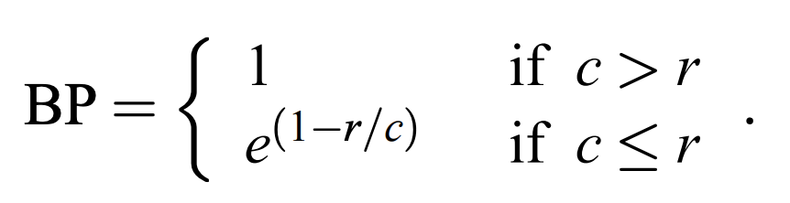
BLEU Score
Brevity Penalty
Candidate의 길이가 Reference 보다 짧으면 Penalty를 줌
BP = 1 (Candidate이 짧지 않을 때)
BP < 1 (Candidate이 짧을 때)
길이가 짧아질수록 지수적(exponential)으로 penalty를 받도록 함.

Slide 138
BLEU Score
Finally

Slide 139
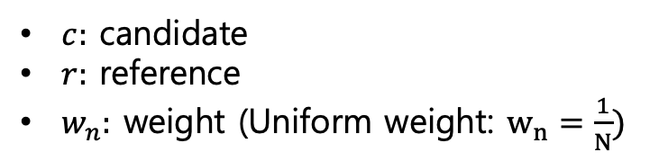
BLEU Score
Finally
$c:$ candidate
$r:$ reference
$w_{n}:$ weight (Uniform weight: $w_{n}=\frac{1}{N})$

Slide 140
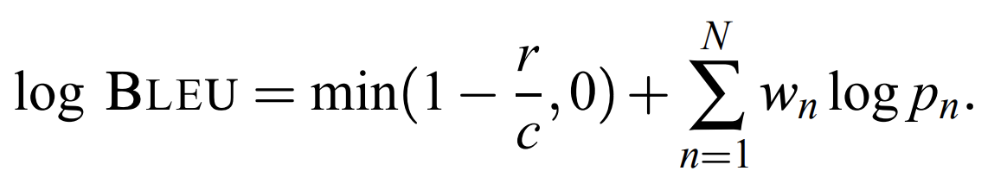
BLEU Score
Finally (Log)

Slide 141
BLEU Score
Disadvantage of BLEU

Slide 142
BLEU Score
Disadvantage of BLEU
BLEU doesn’t consider meaning
BLEU doesn’t directly consider sentence structure
BLEU doesn’t handle morphologically rich languages well

Slide 143
Another method
NIST
ROUGE
Perplexity
WER
F-Score
METEOR
TER
etc...

Slide 144
Machine Translation Datasets
WMT Dataset

Slide 145
Machine Translation Datasets
WMT Dataset
Workshop on Statistical Machine Translation
Bilingual Datasets
English-French and French-English
English-Portuguese and Portuguese-English
English-Spanish and Spanish-English
English-German and German-English
English-Chinese and Chinese-English

Slide 146
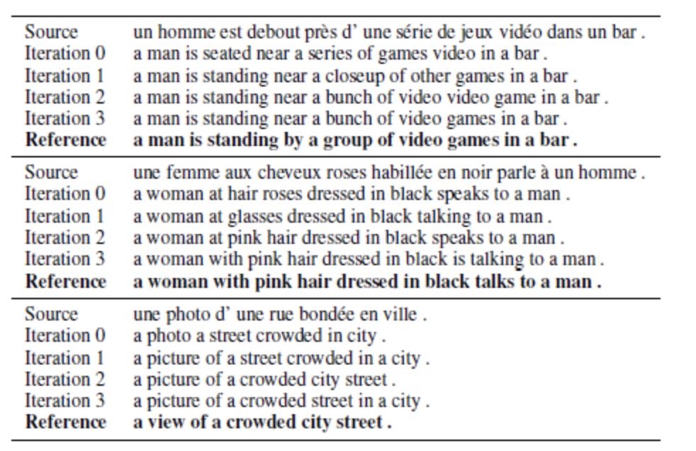
Machine Translation Datasets
WMT Dataset
Workshop on Statistical Machine Translation
Bilingual Datasets
English-French and French-English
English-Portuguese and Portuguese-English
English-Spanish and Spanish-English
English-German and German-English
English-Chinese and Chinese-English

